Slide 1


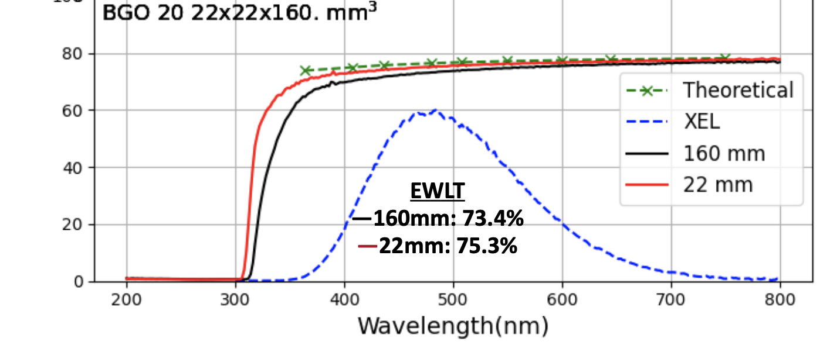
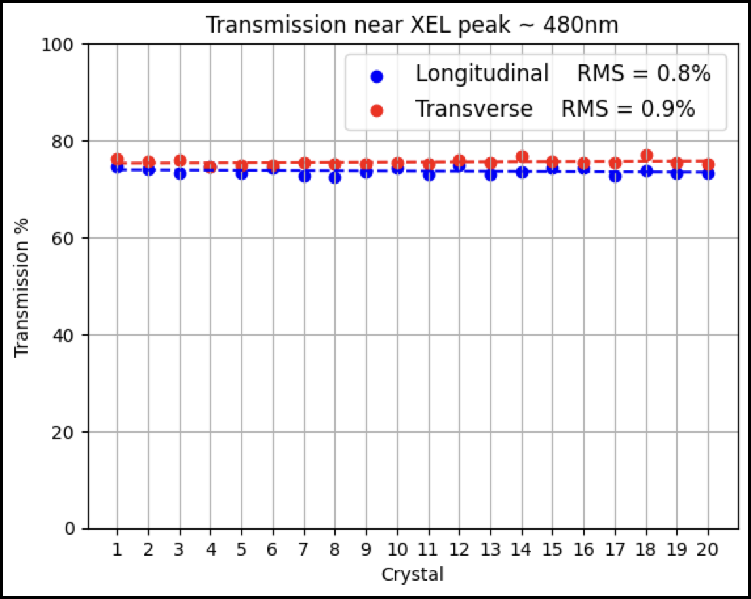
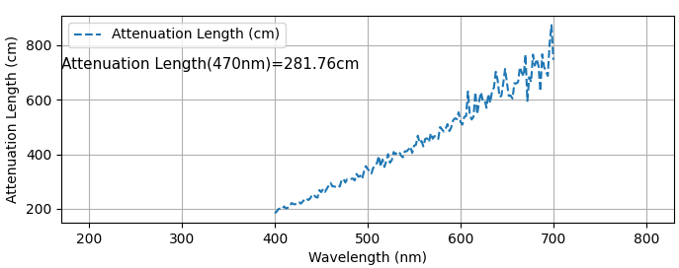
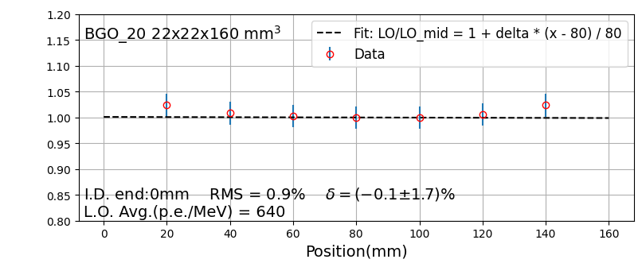
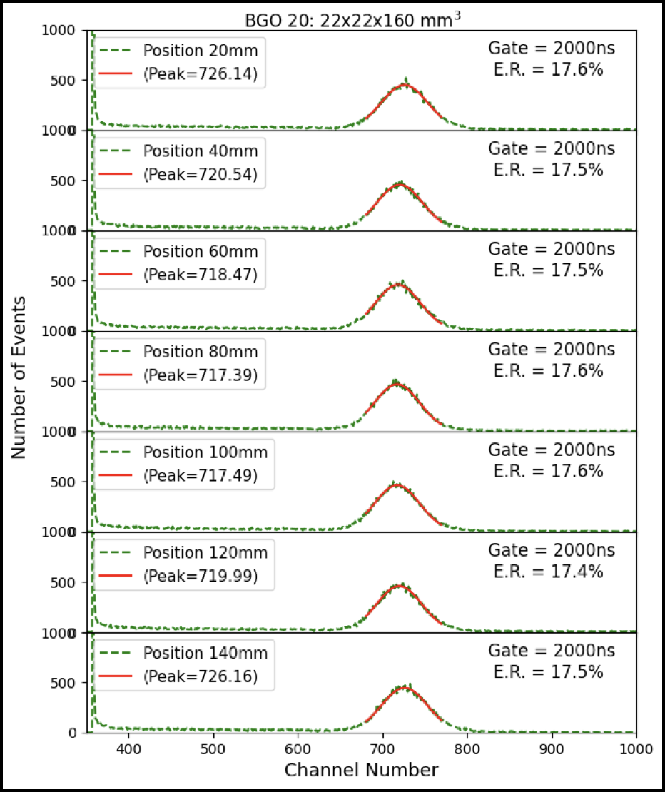
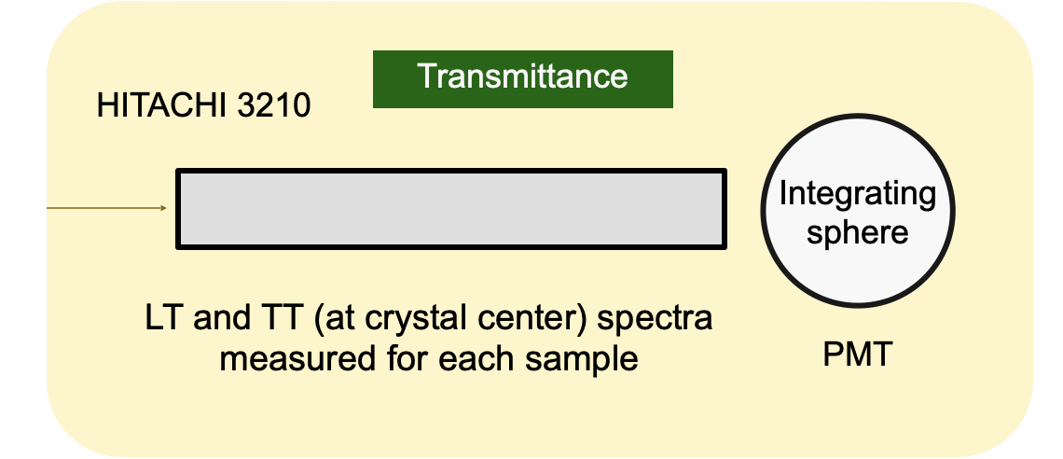
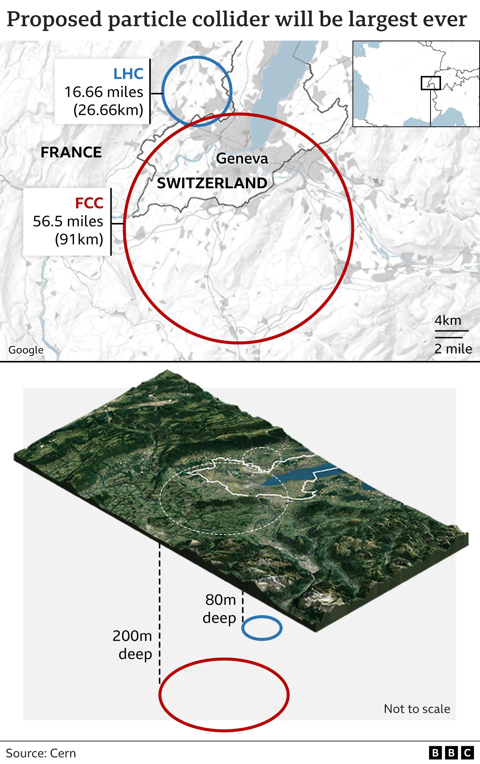
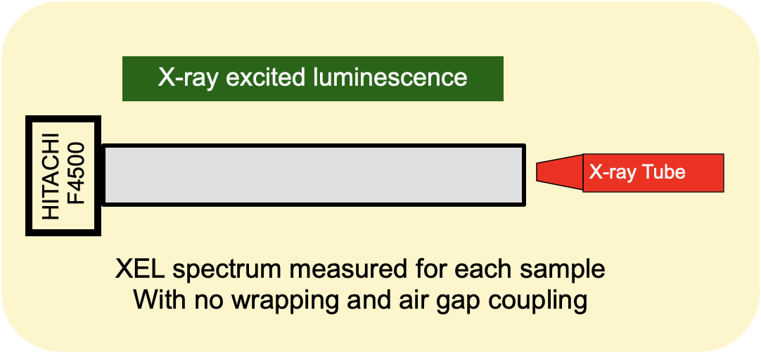
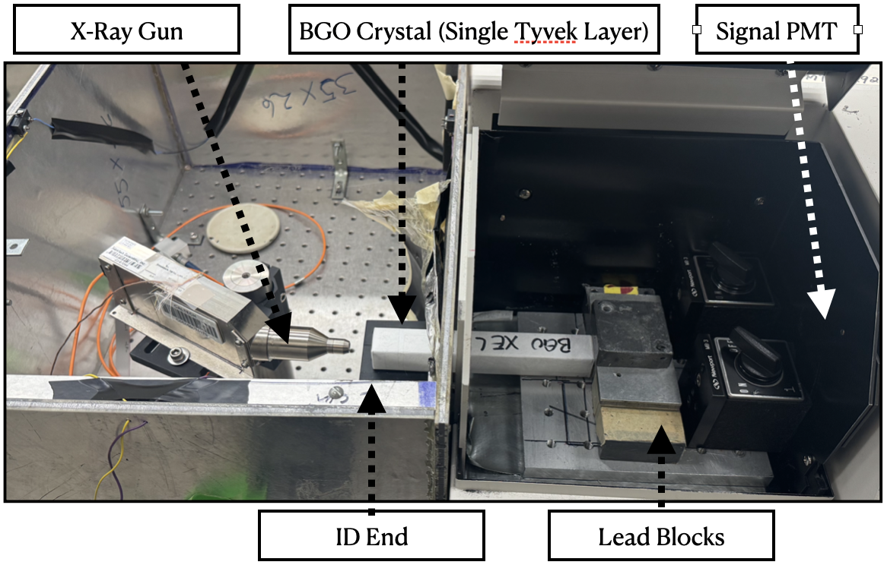
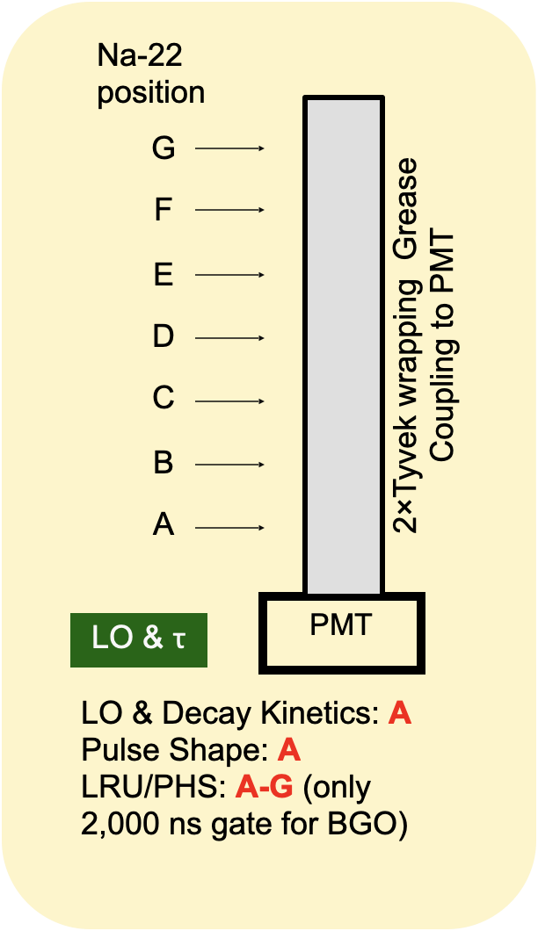
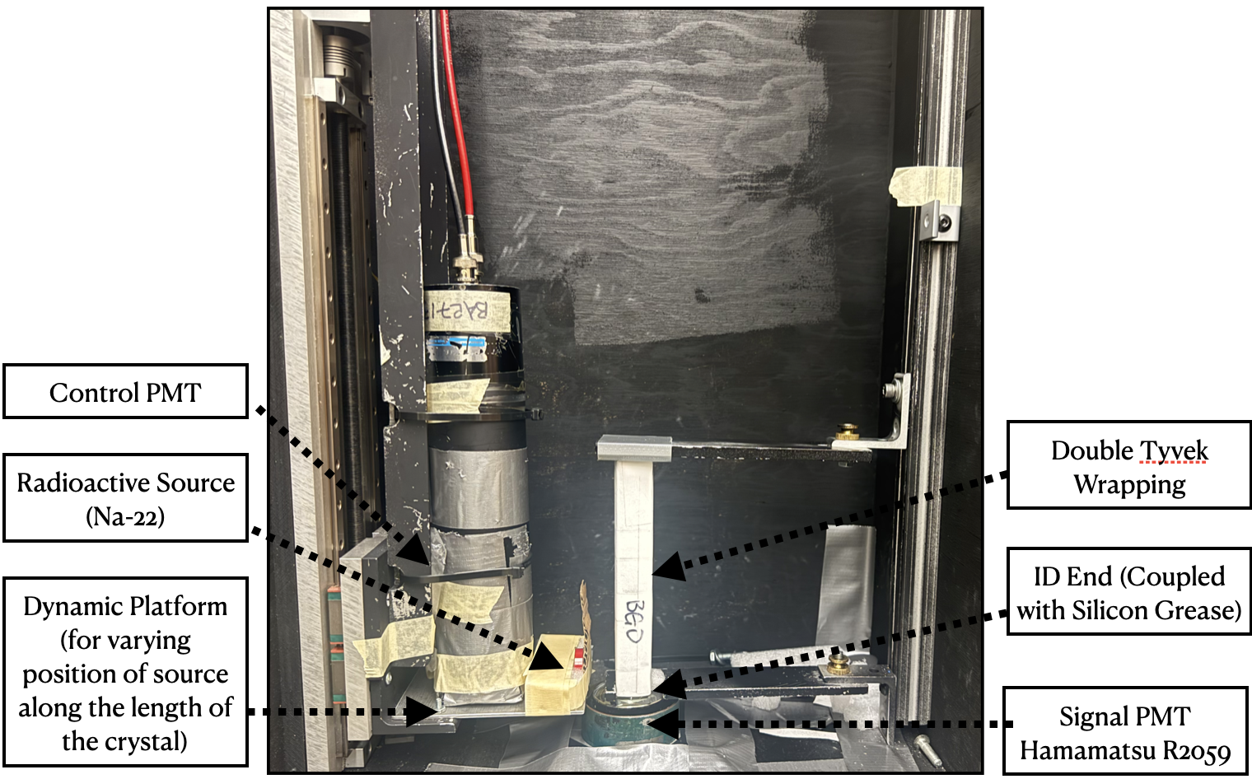
Crystal Characterization for Calorimetry at the Future Circular Collider
Bhavya Singhal¹, Shin-Shan Eiko Yu¹ ,Rachel Bartek¹, Aaron Dominguez¹, Harvey B. Newman², Liyuan Zhang²
¹ The Catholic University of America, Washington DC
²California Institute of Technology-Caltech
Introduction
Methodology
Results
In particle physics, “calorimetry” refers to the detection of particles and measurement of their properties by complete absorption of the particle’s energy in a bulk of matter, referred to as a calorimeter.
Future Circular Collider (FCC) is a proposed future collider that would give access to a variety of new physics measurements. Precision measurements of visible energies via calorimeters hence play crucial role in probing physics at very high energy scales.
Calvision is a consortium of universities and Department of Energy laboratories focused on advancing state-of-the-art calorimetric measurements for all types of particles. The program prioritizes the development of homogeneous calorimeters that maximize the use of available information.
Key aspects of this program include, harnessing ‘dual readout’ of scintillation light signals and Cherenkov radiation (special radiation produced when a particle moves faster than the speed of light in that medium), utilizing timing to distinguish, and developing new algorithms to analyze the two signals.
Scintillation is the process where a certain material media emits specific light signals upon absorbing energy from the particle shower produced in the particle collider
As part of this initiative, CUA’s high-energy physics group plans to establish a crystal testing facility to characterize candidate crystals to be used in the calorimeter.
This classification involves studying the following properties of the crystal:
Transmission spectrum
X-ray excited emission spectrum
Pulse Height Spectra and Light Response Uniformity(LRU)
Light Output and Decay Time(𝛕) of scintillation
Crystal samples of an inorganic scintillator, Bismuth Germanate (Bi₄Ge₃O₁₂) – BGO were tested in the Crystal HEP lab at Caltech as part of the knowledge transfer to CUA.
Transmission Spectra, XEL and Attenuation Length
Transmission %
Shows uniformity across the different crystal samples
Setups
LRU, Time Decay and PHS
Transmission Spectra
Normalized Light Output(au.)
X-Ray Excited Luminescence (XEL)
Light Response Uniformity and Time Responsivity- Decay Time
Discussions and Future Plans
Successful testing of 20 good quality BGO crystals was done with
Scintillation peak(~480nm) measured by XEL spectrum
High EWLT and low RMS values for LRU along with theoretically accurate decay time ensures the quality of crystals.
These crystals will be sent to the test beam at DESY for the crystal matrix tests
We plan to test different scintillators samples and characterize them based on the properties studied to determine the scintillators best suited for dual readout calorimetry
References
Ren-yuan Zhu 2009 J. Phys.: Conf. Ser. 160 012017
https://doi.org/10.48550/arXiv.2502.21223
https://doi.org/10.48550/arXiv.2408.10466
https://home.cern/

